Slide 1
Feedback and Guidelines on Writing the Project Introduction
for the Communication Skills component of ENME203 Project Part 3

Slide 2
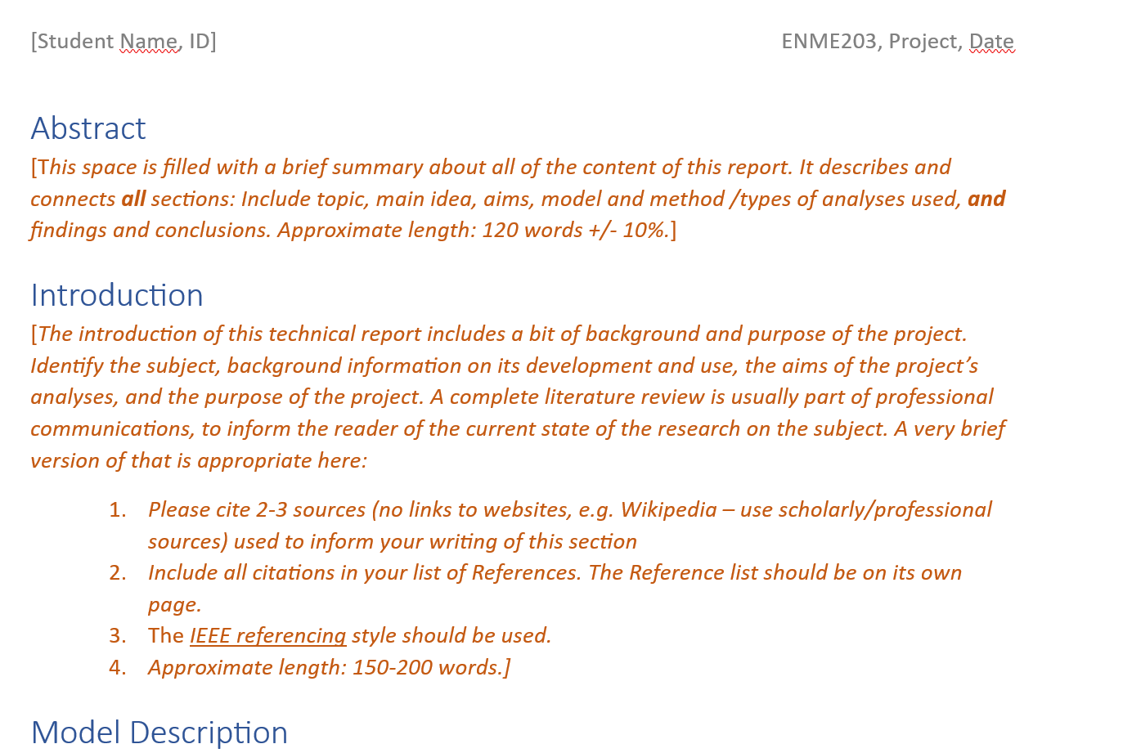
Following the brief (template) carefully will produce good results:

Slide 3
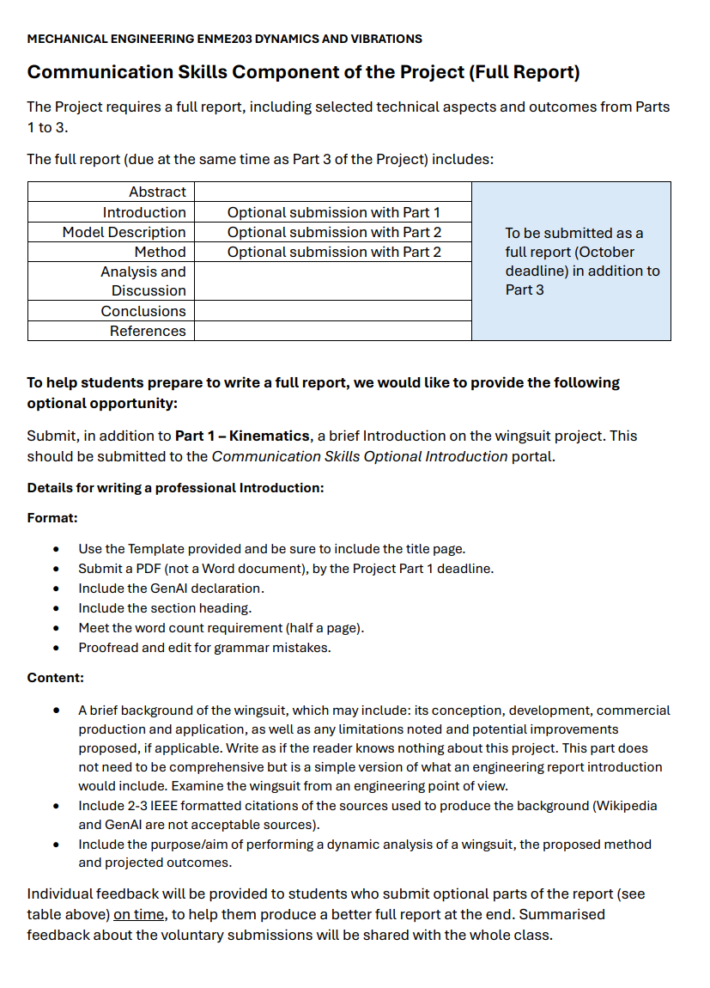
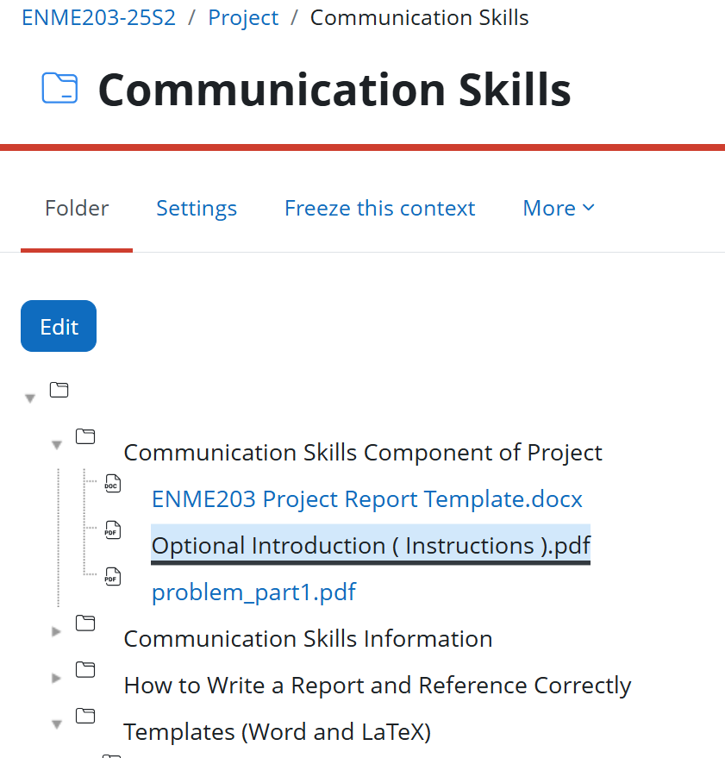
Following the Communication Skills guidelines carefully will produce even better results:

Slide 4
Following the brief carefully will produce good results:
THE BRIEF (from the template):
Introduction
[The introduction of this technical report includes a bit of background and purpose of the project. Identify the subject, background information on its development and use, the aims of the project’s analyses, and the purpose of the project. A complete literature review is usually part of professional communications, to inform the reader of the current state of the research on the subject. A very brief version of that is appropriate here:
Please cite 2-3 sources (no links to websites, e.g. Wikipedia – use scholarly/professional sources) used to inform your writing of this section
Include all citations in your list of References. The Reference list should be on its own page.
The IEEE referencing style should be used.
Approximate length: 150-200 words.]

Slide 5
Following the brief carefully will produce good results:
In the following slides, the red text contains tips about how to respond to the yellow highlighted text in the brief.

Slide 6
Following the brief carefully will produce good results:
Introduction: Use template section headings like this one, and all settings. Delete unused template parts.
[The introduction of this technical report includes a bit of background and purpose of the project. Identify the subject, background information on its development and use, the aims of the project’s analyses, and the purpose of the project. A complete literature review is usually part of professional communications, to inform the reader of the current state of the research on the subject. A very brief version of that is appropriate here:
Please cite 2-3 sources (no links to websites, e.g. Wikipedia – use scholarly/professional sources) used to inform your writing of this section
Include all citations in your list of References. The Reference list should be on its own page.
The IEEE referencing style should be used.
Approximate length: 150-200 words.]

Slide 7
Following the brief carefully will produce good results:
Introduction:
[The introduction of this technical report includes a bit of background and purpose of the project. Include these three things.
Identify the subject, background information on its development and use, the aims of the project’s analyses, and the purpose of the project. A complete literature review is usually part of professional communications, to inform the reader of the current state of the research on the subject. A very brief version of that is appropriate here:
Please cite 2-3 sources (no links to websites, e.g. Wikipedia – use scholarly/professional sources) used to inform your writing of this section
Include all citations in your list of References. The Reference list should be on its own page.
The IEEE referencing style should be used.
Approximate length: 150-200 words.]

Slide 8
Following the brief carefully will produce good results:
Introduction
[The introduction of this technical report includes a bit of background and purpose of the project. Identify the subject, background information on its development and use, the aims of the project’s analyses, and the purpose of the project.
Identify the subject, and describe it in technical terms. It is fine to spend one sentence telling the reader the origins of a wingsuit, but then stop – the idea is to write a technical description of the topic, as if you are an engineering contractor, filling this brief for a client or an employer.
For this report, very briefly (one or two sentences) write a bit about the development since inception and how it is used currently.
A first step is to identify the type of analysis used for the project (dynamic /kinematic etc), but what are the AIMS of that analysis? As an engineer, how would that analysis answer a question or solve a problem in a project you were given?
Always include the purpose of the project/study. Think about and develop this answer: As an engineer, what is a possible application for that analysis’ results? (Sure, one purpose is to help students to learn stuff…go deeper.)
A complete literature review is usually part of professional communications, to inform the reader of the current state of the research on the subject. A very brief version of that is appropriate here:
Please cite 2-3 sources (no links to websites, e.g. Wikipedia – use scholarly/professional sources) used to inform your writing of this section
Include all citations in your list of References. The Reference list should be on its own page.
The IEEE referencing style should be used.
Approximate length: 150-200 words.]

Slide 9
Following the brief carefully will produce good results:
Introduction
[The introduction of this technical report includes a bit of background and purpose of the project. Identify the subject, background information on its development and use, the aims of the project’s analyses, and the purpose of the project. A complete literature review is usually part of professional communications, to inform the reader of the current state of the research on the subject. A very brief version of that is appropriate here:
This is just FYI – in a professional or academic report, a literature review (research about what the experts are doing or have done so far, to find out the current state of the topic) would be expected. It is not required here. But, a literature review informs the researcher as well as the reader, and helps them get their head around the status of a problem and potential solutions.
Students are not asked to do a little research and write an Introduction as an exercise in pretty writing. Knowing that a man died jumping off the Eiffel Tower in a wingsuit is interesting (if macabre…)but is that the kind of background that really contributes to this project’s aims? Educate yourself a little.
Please cite 2-3 sources (no links to websites, e.g. Wikipedia – use scholarly/professional sources) used to inform your writing of this section
Include all citations in your list of References. The Reference list should be on its own page.
The IEEE referencing style should be used.
Approximate length: 150-200 words.]

Slide 10
Following the brief carefully will produce good results:
Introduction
[The introduction of this technical report includes a bit of background and purpose of the project. Identify the subject, background information on its development and use, the aims of the project’s analyses, and the purpose of the project. A complete literature review is usually part of professional communications, to inform the reader of the current state of the research on the subject. A very brief version of that is appropriate here:
Please cite 2-3 sources (no links to websites, e.g. Wikipedia – use scholarly/professional sources) used to inform your writing of this section
www.redbull.com is not a scholarly source. Just FYI. ☺
Use Google Scholar or the library or other search engines to find some articles that have been published in professional/academic journals. You don’t need to read books on the subject or understand it all – a brief background is fine. You will be better informed. (FYI – The first four Introductions I read named three different men who jumped off the Eiffel Tower in 1912 and died (There was only one.), some of whom weren’t even born then…)
Do not make stuff up. Your markers will be very well versed in wingsuit backgrounds by the time they read yours. The other professionals/academics who will read your work in later life will also be able to spot poor research.
Include all citations in your list of References. The Reference list should be on its own page.
The IEEE referencing style should be used.
Approximate length: 150-200 words.]

Slide 11
Following the brief carefully will produce good results:
Introduction
[The introduction of this technical report includes a bit of background and purpose of the project. Identify the subject, background information on its development and use, the aims of the project’s analyses, and the purpose of the project. A complete literature review is usually part of professional communications, to inform the reader of the current state of the research on the subject. A very brief version of that is appropriate here:
Please cite 2-3 sources (no links to websites, e.g. Wikipedia – use scholarly/professional sources) used to inform your writing of this section
Include all citations in your list of References. The Reference list should be on its own page.
If you cite it, reference it. Don’t reference things you didn’t cite.
Cite things in order of appearance ( [1], [2], [3]). Reference them in the same order.
The IEEE referencing style should be used.
Approximate length: 150-200 words.]

Slide 12
Following the brief carefully will produce good results:
Introduction
[The introduction of this technical report includes a bit of background and purpose of the project. Identify the subject, background information on its development and use, the aims of the project’s analyses, and the purpose of the project. A complete literature review is usually part of professional communications, to inform the reader of the current state of the research on the subject. A very brief version of that is appropriate here:
Please cite 2-3 sources (no links to websites, e.g. Wikipedia – use scholarly/professional sources) used to inform your writing of this section
Include all citations in your list of References. The Reference list should be on its own page.
The IEEE referencing style should be used.
Use research management software to help you. Don’t just make stuff up.
Approximate length: 150-200 words.]: Use this as a guide. Too many words? You can probably delete something. Too short? Your description may need more depth, or you probably need to expand on the purpose and application part.

Slide 13
Following the Communication Skills guidelines carefully will produce even better results:

Slide 14
Following the Communication Skills guidelines carefully will produce even better results:
Communication Skills Component of the Project (Full Report)
The Project requires a full report, including selected technical aspects and outcomes from Parts 1 to 3.
The full report (due at the same time as Part 3 of the Project) includes:
Abstract |  | To be submitted as a full report (October deadline) in addition to Part 3
Introduction | Optional submission with Part 1
Model Description | Optional submission with Part 2
Method | Optional submission with Part 2
Analysis and Discussion
Conclusions
References

Slide 15
Following the Communication Skills guidelines carefully will produce even better results:
Details for writing a professional Introduction:
Format:
Use the template provided and be sure to include the title page.
Submit a PDF (not a Word document), by the Project Part 3 deadline.
Include the GenAI declaration. (more later)
Include the section heading.
Meet the word count requirement.
Proofread and edit for grammar mistakes.

Slide 16
Following the Communication Skills guidelines carefully will produce even better results:
Details for writing a professional Introduction:
Content:
A brief background of the wingsuit, which may include: its conception, development, commercial production and application, as well as any limitations noted and potential improvements proposed, if applicable. Write as if the reader knows nothing about this project. This part does not need to be comprehensive but is a simple version of what an engineering report introduction would include. Examine the wingsuit from an engineering point of view.
Include 2-3 IEEE formatted citations of the sources used to produce the background (Wikipedia and GenAI are not acceptable sources).
Include the purpose/aim of performing a dynamic analysis of a wingsuit, the proposed method and projected outcomes.

Slide 17
Feedback compiled from the optional Introductions students submitted:
Format
Name the submission helpfully (Walker Part 3) (not ‘FinalFinalFinaldraft’).
Submit a PDF version.
Delete all traces of the template.
Remove the brackets in the header.
When a citation is at the end of a sentence and refers to content from that sentence, the full stop goes after the brackets, like this [1].
Check word count. It’s helpful to include it in each section requiring it, in brackets after the subheading, or at the end.
Follow all guidelines given, such as those in the Communication Skills folder.

Slide 18
Feedback compiled from the optional Introductions students submitted:
Professional Writing:
Avoid contractions (aren’t – are not, don’t – do not, etc).
Avoid vague phrases (for a long time, in many ways, some ).
Avoid informal language (majorly, cool, random).
Refer to the ‘project/study/research’ advancing the research or achieving an aim or purpose – not the ‘report’.
Use paragraphs.
Check punctuation and use a spell checker or grammar software.
Follow all guidelines given, such as those in the Communication Skills folder.

Slide 19
Feedback compiled from the optional Introductions students submitted:
Content:
Respond to every part of the brief (Do not just give a background story.).
When writing the background, don’t just include a story about the first wingsuit – describe the suit from an engineering point of view too. What aspects of the wingsuit are important to the project? Give a background to the project, not just the wingsuit. Write like an engineer.
While you are researching this and writing the introduction, try to think of a likely conclusion for a project/research like this. Why do this analysis? How could this analysis be helpful to the field of engineering? How could the findings be applied – think like an engineer.
When writing about the purpose, apply that thinking: What if an employer or client asked for the type of analysis you are doing? Describe what will be learned by completing the analysis, from an engineering perspective. How could the findings of the analysis be applied in development of the thing, or in industry?
PS: www.redbull.com is not a scholarly source.

Slide 20
And, if you have questions, please ask!
Christine.walker@canterbury.ac.nz

